Slide 1
Reduce Stress and Find Balance Through Mindfulness Practice
Minnesota Association of Secondary School Principals
2015 Winter Conference
Craig Paul, Principal (retired),
Wayzata High School
Sarah Rudell Beach, Teacher,
Wayzata High School

Slide 2
Presenters
Craig Paul, Ph.D., retired principal, 40+ years as HS principal
MN experience: Holdingford Junior/Senior High (5 years), Wayzata High School (15 years),
Park High, Cottage Grove (15-month interim)
AIS Cairo, Egypt (2 years)
Sarah Rudell Beach, M.Ed., teacher, Wayzata High School
Social Studies teacher (17 years): AP European History, Psychology, World Religions, Anthropology
Mindful Schools© instructor, trained in Mindfulness-Based Stress Reduction, Huffington Post contributor

Slide 3
Presentation Outline
What is Mindfulness?
Research Overview
Mindfulness in Education
Personal Practice
Mindful Teaching
Teaching Mindfulness
The Role of the Administrator

Slide 4
What is Mindfulness?

Slide 5
What is Mindfulness?
Mindfulness is paying attention…
On purpose,
And without judgment
We can be mindful of our senses, and of our inner world of thoughts and emotions.
It helps us to respond, not react.
It is simple. But it is not often easy.

Slide 6
Have you ever…?
said something you later regretted?
been so nervous for a presentation or an event that you couldn’t sleep the night before?
walked into a room to get something, and then forgot what you were looking for?
been really sad or upset but you didn’t know exactly why?
been so engrossed in a novel or a sewing project or a golf game or some other hobby that everything else fell away and that activity commanded your full focus and attention?

Slide 7
What is Mindfulness?
“Between stimulus and response there is a space. In that space is our power to choose our response. In our response lies our growth and our freedom.”
Victor Frankl

Slide 8
Without Mindfulness:
Stimulus
Reaction
With Mindfulness:
Stimulus
Mindfulness
Choice
Response
Notes:
Stimulus – Mindfulness- Choice – Response, vs Stimulum – Responses

Slide 9
The Language of Mindfulness
ATTENTION Authenticity BALANCE Breathing BIO RYTHYM Body Scan CLARITY Compassion DISTANCING Driving Force EMOTIONAL ANOMIE Finitude FORGIVENESS Generosity GRATITUDE Interconnectedness LEGACY Love MEDITATION Meta-Cognition MINDSET Movement PARADOX Presence REFLECTION Silence STRESS REDUCTION Selective Eating WHOLENESS Zoning in (Equanimity)

Slide 10
Your greatest gift is your
BREATH

Slide 11
Where is Mindfulness Today?
60 Minutes Dec.14 2014
Time magazine issue Jan 2014
Draft Day movie
Pro Champs Seattle Seahawks 2013
720 Medical Schools world-wide with MBSR
U of MN Center for Spirituality and Healing
Mayo Clinic Mind Body Medicine Initiative
General Mills Mindful Leadership Program

Slide 12
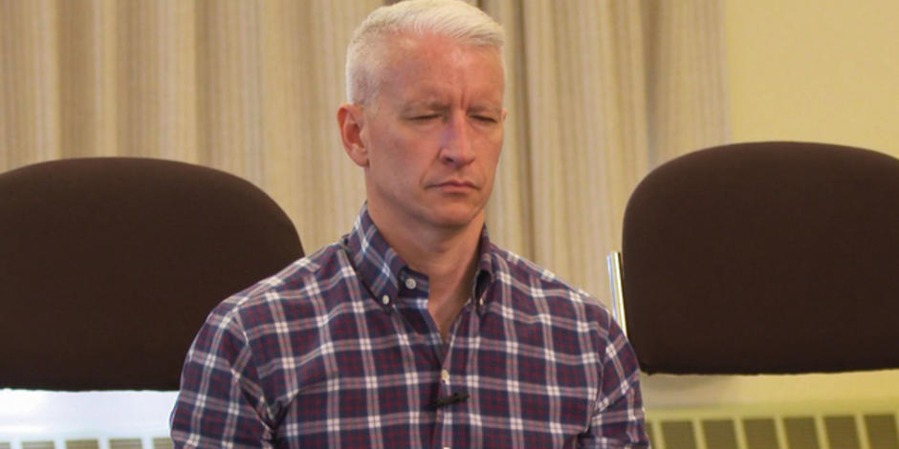
Mindfulness on 60 Minutes

Slide 13
Super Bowl Champs 2014

Slide 14
Where is Mindfulness Today?

Slide 15
Where is Mindfulness Today?
University of Minnesota – Twin Cities

Slide 16
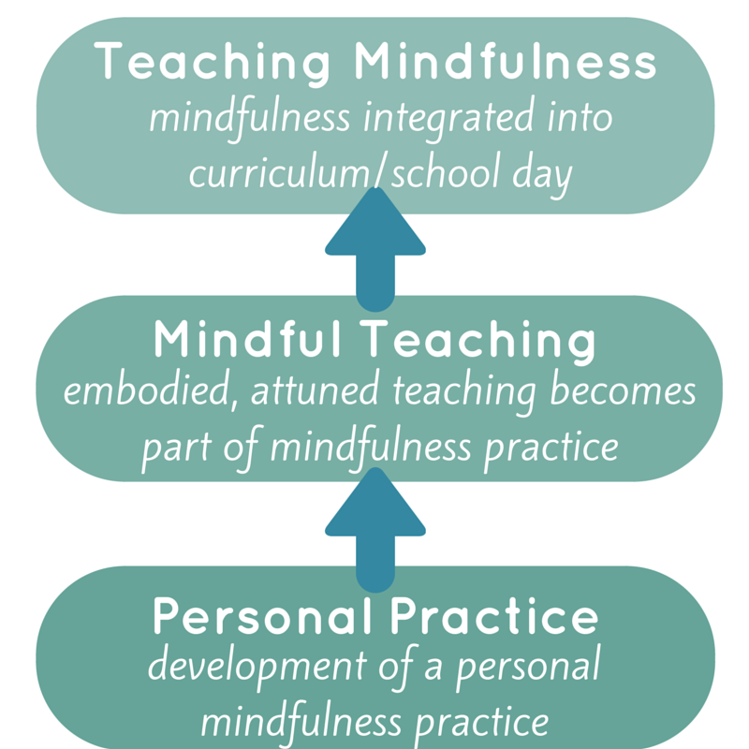
Mindfulness in Schools
© Sarah Rudell Beach

Slide 17
What Mindfulness is NOT
“Thinking about nothing.”
It’s being aware of our thoughts.

Slide 18
What Mindfulness is NOT
Being happy ALL THE TIME and loving EVERY SINGLE MINUTE of life.
It’s bringing non-judgmental awareness to the present moment.

Slide 19
What Mindfulness is NOT
Religious.
It can be a secular practice.
It is mental training.
It is supported by clinical research.
It is integrated into many workplaces, including Google, General Mills, and the Huffington Post

Slide 20
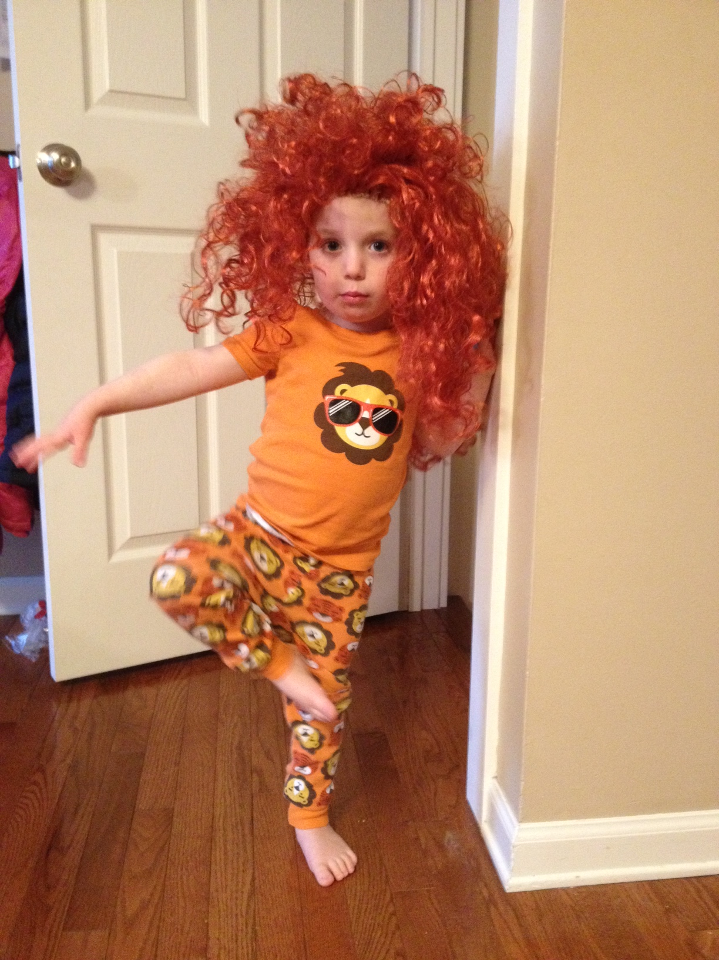
What Mindfulness is NOT
Long periods of passive sitting and navel-gazing.
It can be active!
Yoga, walking, daily routines…

Slide 21
What Mindfulness is NOT
Living only in the present. Never thinking about the past or planning for the future.
It is awareness and deliberate attention – even on the act of planning...
“Is this useful?”

Slide 22
What Mindfulness is NOT
Relaxation.
It might be relaxing. It might be boring and annoying. It’s being with WHAT IS.

Slide 23
What Mindfulness is NOT
Zoning out.
It’s zoning IN. It is purposeful awareness.

Slide 24
What Mindfulness is NOT
A form of classroom discipline.
It is about teaching children to be with ALL aspects of their experience.
It often does create a quiet, focused classroom, but it is not intended to be used to get kids to pay attention for hours on end!

Slide 25
The Benefits of Mindfulness – For Teachers
Improves focus and awareness
Increases responsiveness to student needs and enhances classroom climate
Promotes emotional balance and stress management
Supports healthy relationships – at work and at home
Studies show practicing mindfulness not only improves teachers’ mental well-being, but makes them more effective in the classroom

Slide 26
The Benefits of Mindfulness – For Students
Improved attention, focus, and concentration
Attentional stability is key to learning!
Reduced stress (ability to calm down when upset)
Gives youth a “nervous system toolkit”
Increased self-awareness (ability to recognize emotions)
Improved impulse control
Increased empathy (for self and others)
Can be especially helpful for ADHD students

Slide 27
Mindfulness in Medical, Clinical, & Educational Settings -- Overview
Jon Kabat-Zinn and the University of Massachusetts Medical Center
Late 1970s – Mindfulness-Based Stress Reduction (MBSR)
Mindfulness training had a positive impact on chronic pain, stress, and overall well-being, memory, immune response, self-control, attention, recovery from addiction, and emotional resilience
MBSR is now offered at over 700 hospitals, clinics, and universities worldwide – in virtually every major US metro area!

Slide 28
Mindfulness in Medical, Clinical, & Educational Settings -- Overview
Mental Health: Clinical and therapeutic settings
Mindfulness-Based Cognitive Therapy (MBCT) -- 1990s
To treat depression, and depression relapse
Now used on a national level in UK health care policy
Set the stage for use with child and adolescent populations
Reduces symptoms of anxiety, depression, and increases self-esteem and sleep quality (studies on ages 14-18)

Slide 29
Mindfulness in Medical, Clinical, & Educational Settings -- Overview
Educational Settings
Sporadic school-based programming by educators with a background in MBSR – late 1980s
Social-emotional learning (SEL) programs often include material on attentional control and self-regulation
Currently in the process of validating results of mindfulness-based interventions (MBIs) with children
Early 2000s – teaching mindfulness to teachers as a self-care and wellness tool

Slide 30
Current State of Research
In 1983, there were only three peer-reviewed scientific studies of meditation.
By 2013, there were more than 1300!
Studies now coming out at the rate of 40 a month!

Slide 31
Mindfulness in Education: Research
UCLA study found improved executive function in 2nd and 3rd graders
Mindful Schools study (in collaboration with UC Davis, 2011-2012)
Study of 829 K-5 students (90% F/RL)
Statistically significant improvements in attention, self-care and participation, and showing care for others

Slide 32
Personal Practice

Slide 33
Personal Practice
A daily practice can consist of intentional moments for:
Mindful breathing
Mindful listening
Body Scan practice
Mindful moments throughout the day (where is my attention?)
While washing dishes, driving to work, eating breakfast, etc.
Free audio guide downloads available from the UCSD Center for Mindfulness: http://health.ucsd.edu/specialties/mindfulness/programs/mbsr/Pages/audio.aspx

Slide 34
Mindful Teaching

Slide 35
Teaching Mindfully
“The foundation for teaching mindfully is always our own mindfulness practice.”
Daniel Rechtschaffen

Slide 36
Mindfulness for Teachers: Research
2013 study by the Center for Investigating Healthy Minds at the University of Wisconsin-Madison
Randomized, controlled study found that teachers who participated in a modified MBSR program experienced:
Reduction in burnout and symptoms of psychological distress
Improvement in classroom organization and increased effective teaching behaviors
Increased self-compassion
Reduction in attentional biases

Slide 37
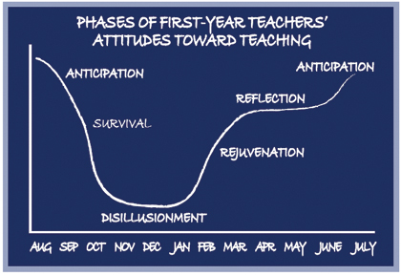
Ellen Moir, Director of the Santa Cruz Consortium New Teacher Project and Director of Student Teaching at UC Santa Cruz

Slide 38
The Qualities of a Mindful Teacher
Compassion
Understanding
Boundaries
Attention
Intention
Authenticity

Slide 39
Mindful Teaching
Mindful teaching involves several components:
Personal practice
Embodied teaching – an attuned presence
Awareness and responsiveness
Relational mindfulness
It draws from neuroscience, biology, positive psychology, and mindfulness

Slide 40
Mindful Teaching
What is the condition of a teacher’s nervous system when in the classroom?
Are they present, attuned, and empathic?
Or are they burnt out, fatigued, anxious, or in some kind of stress response?

Slide 41
Mindfulness and Teaching: Embodied Teaching
Voice quality (prosody)
Posture
Facial Expression – congruence
Cycles of activation and deactivation
Energy
Presence and authenticity – Relationships
Equanimity

Slide 42
Teaching Mindfulness

Slide 43
Teaching Mindfulness
Various models:
Outside organizations/providers can teach lessons to K-12 classes (generally 16 lessons taught over 8 or 16 weeks)
Ex: M2 Foundation (St. Paul)
Individual teachers implement curriculum in their classrooms, after receiving training
Ex: Mindful Schools, .b, MindUp
Integrate mindfulness into school routines and transitions
Requires teachers and staff with mindfulness background

Slide 44
Teaching Mindfulness: The Two Most Important Things!
Teaching mindfulness is always grounded in personal practice (authenticity)
The mindfulness instructor makes the lessons their own (this will come out of the first one!)

Slide 45
Teaching Mindfulness
Mindfulness is an invitation. Allow students to opt out.
Mindfulness is not classroom management, and should not be used as a punishment.
It’s not about making the classroom calm and quiet, though that may happen…
Teachers should be aware of practices that may be difficult for students with a history of trauma, and know of available resources

Slide 46
Teaching Mindfulness: Share the purpose with kids
Mindfulness is teaching a set of life skills – an “owner’s manual for the brain”
A set of experiments; a maintenance manual
How mindfulness can help them (attention, self-regulation)
We’re checking in with our internal and external experience – becoming aware of the activity of the mind, and how we interact with the environment.
We’re learning how to meet our everyday experiences.
We’re learning how to “be with” an experience, how to respond instead of reacting

Slide 47
Teaching Mindfulness
Direct instruction of lessons (15+ minute modules), plus mindful moments integrated through the day or week
Where does mindfulness fit as a foundational support of what we already do? (SEL programs, anti-bullying programs, conflict-resolution skills, etc.)
Classroom routines:
Moment of mindfulness (start, middle, end of period)
“Notice how you’re feeling right now.”
“Where is your attention right now?”
Movement exercises

Slide 48
What’s the Administrator’s Role?

Slide 49
To Learn More…
Mindful Schools: http://mindfulschools.org
The Greater Good Science Center at UC-Berkeley: http://greatergood.berkeley.edu/
Guardian Teacher Network Resources: http://www.theguardian.com/teacher-network
http://mindfulnessinschools.org/
The Center for Mindfulness at the University of Massachusetts: http://www.umassmed.edu/cfm/index.aspx
Mindful Magazine: http://mindful.org
The Mindsight Institute (UCLA): http://www.drdansiegel.com

Slide 50
To Learn More…
Full Catastrophe Living by Jon Kabat-Zinn
Search Inside Yourself by Chade-Meng Tan
Finding the Space to Lead by Janice Marturano
The Mayo Clinic Guide to Stress-Free Living
10% Happier by Dan Harris
A Mindful Nation by Congressman Tim Ryan
Mindfulness: An Eight-Week Plan for Finding Peace in a Frantic World by Mark Penman and Danny Williams

Slide 51
To Learn More…
Mindful Teaching and Teaching Mindfulness by Deborah Schoeberlein David and Suki Sheth
The Way of Mindful Education by Daniel Rechtschaffen
The Mindful Brain by Dan Siegel

Slide 52
Contact Information
Craig Paul: cpaulctt@gmail.com
763.464.9500
Sarah Rudell Beach: sarah.rudell.beach@wayzata.k12.mn.us
952.484.1211

